Slide 1
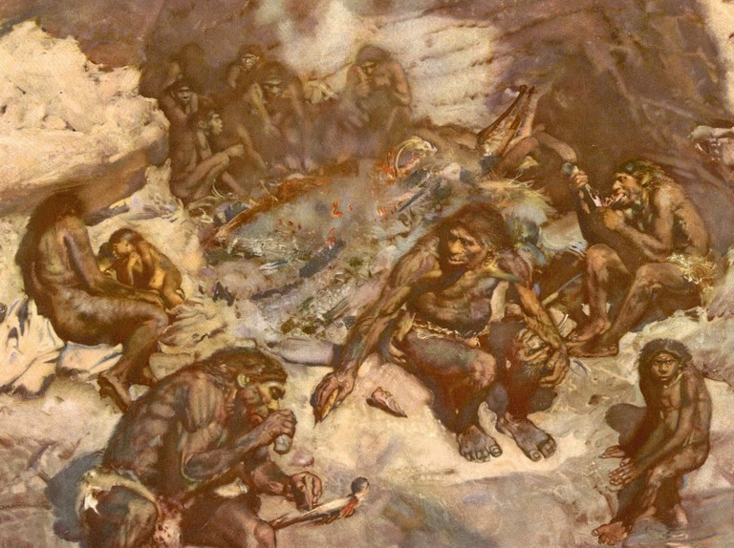
Human Ancestors- Transition to Modern Humans
Homo heidelbergensis
Homo neanderthalensis
Other extinct recent hominins
Homo sapiens

Slide 2
Date: | Human Biology Year 12 ATAR
Do Now Hand in review worksheet Lesson Agenda 1: Do Now 2: Transition to Modern Humans 3: Lesson summary and windup Suggested Study Read through today’s notes and textbook section Complete review worksheet, then mark and correct using the answer key on Connect (compulsory). NEXT LESSON Cultural Evolution human ancestors Early modern humans The Neolithic agricultural revolution Modern humans | Learning Aims Describe the likely evolutionary pathway that led to the evolution of H.neanderthalensis and H.sapiens Provide an overview of H.neanderthalensis including fossil record, time of existence, range and habitat. Describe anatomical features of H. neanderthalensis Describe lifestyle and culture of H.neanderthalensis Briefly describe the location, time range and features of Denisovans Briefly describe the location, time range and features of the Red Deer Cave People Provide an overview of H.sapiens including the fossil record and anatomical features
 | Key Vocabulary Neanderthal Mousterian Industry Core and Flake Hafted Cro Magnon

Slide 3
Homo heidelbergensis / antecessor
Possible (likely?) common ancestor of both Homo sapiens and Homo neanderthalensis
Fossils
found in Africa (dated to 1 mya)
Found in Europe (dated to 500 000 years ago)
Features between H. erectus and H. sapiens
Not enough fossil evidence to fully understand relationships between different Homo species.
Family tree has more branches than at first thought – just all extinct.
One hypothesis:
H. heidelbergensis populations in Europe in cold, extreme conditions due to ice age. Certain body type favoured - evolved into H. neanderthalensis.
H. heidelbergensis populations in Africa had different selection pressures – ice age caused low rainfall, dry environment – poor access to water and food. Problem-solving and high cognitive capacity were a selective advantage – Homo sapiens evolved.
Learning Aim: Describe the likely evolutionary pathway that led to the evolution of H.neanderthalensis and H.sapiens

Slide 4
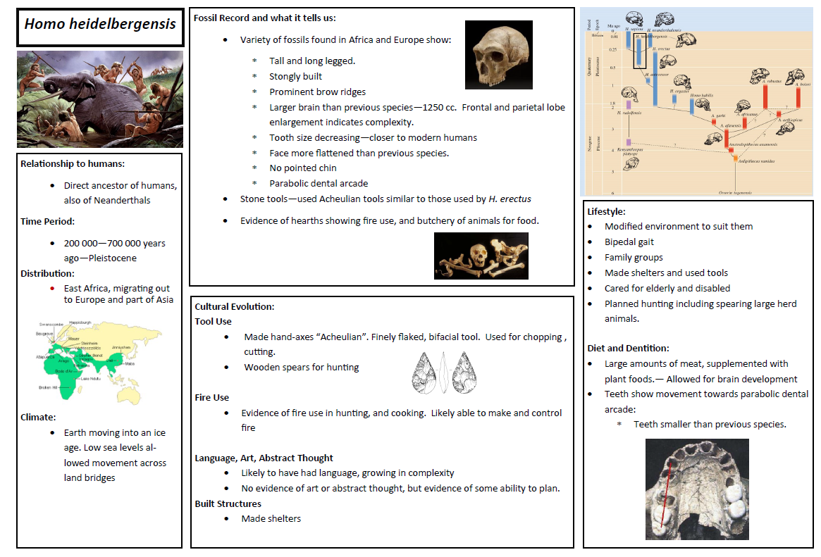

Slide 5
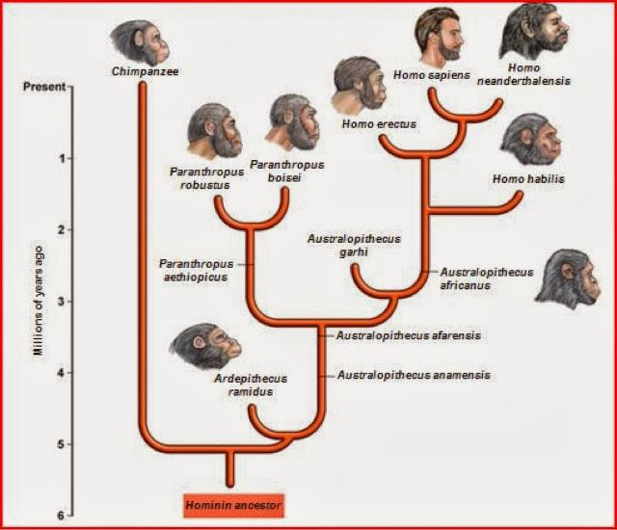
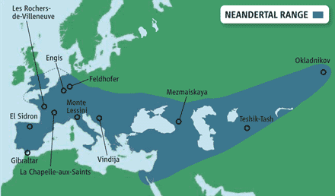
Homo neanderthalensis – The Neanderthals - Overview
First fossils found in 1856 in Neander Valley, Germany
Many more fossils found since.
Side branch along pathway to modern humans – we share a common ancestor
DNA shows a distinct biological species:
Homo neanderthalensis
Existed in Europe during the last ice age and were adapted for those conditions
400 000 years BP to 40 000 year BP
Neanderthals and Homo sapiens coexisted in Europe towards the end of the ice age, and inter-bred.
Learning Aim: Provide an overview of H.neanderthalensis including fossil record, time of existence, range and habitat.

Slide 6
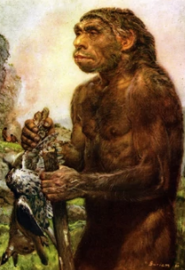
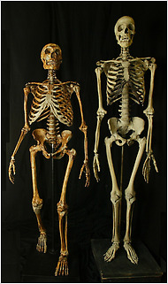
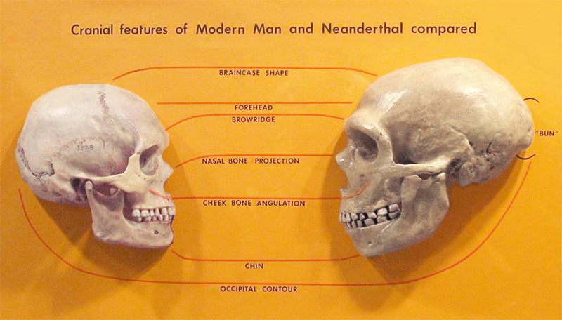
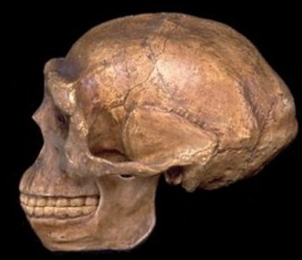
Homo neanderthalensis – Anatomical Features
Features include:
Big faces
Low but large skulls – back of skull drawn out into “bun”
Cranial capacity larger than humans, but frontal cortex smaller
Heavy brow ridges
Lack of defined chin
Cheeks swept back
Somewhat prognathic jaw
Likely to have very prominent, wide nose – adaptation for cold, dry air and to regulate body temperature without sweating
Solid frame – shorter and stockier than H.sapiens
Other skeletal features very similar to Homo sapiens
Probably walked, ran and used hands in way very similar to modern humans
Learning Aim: Describe anatomical features of H. neanderthalensis

Slide 7
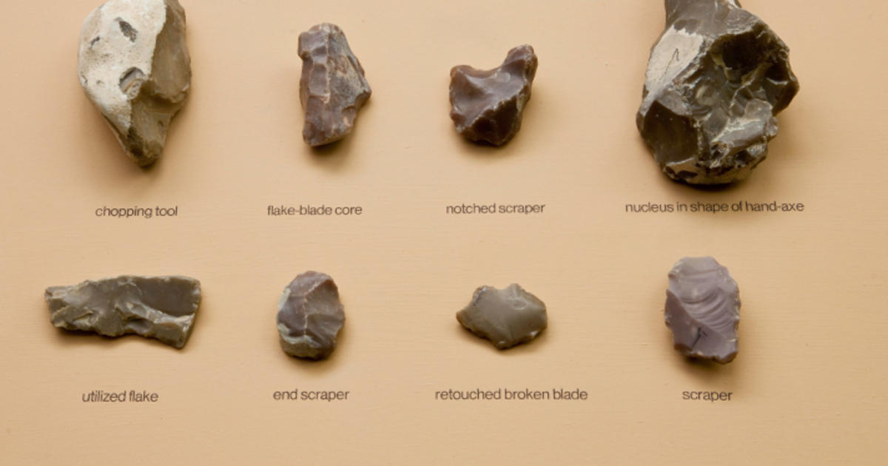
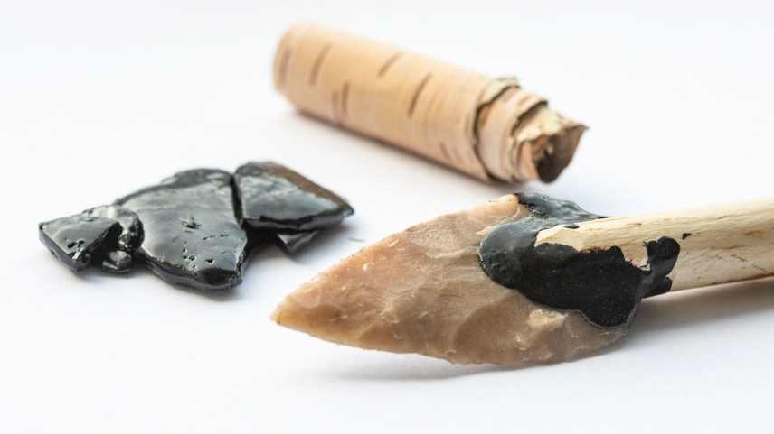
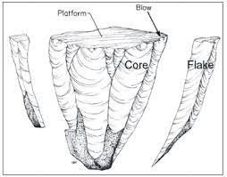
Homo neanderthalensis – Lifestyle and Culture
Specialised hunters
Meat an important part of diet
Plant food sources scarce in ice-bound Europe
Needed energy from animal fats to survive the cold
Made sophisticated stone tools
“Mousterian Industry”
Flaked a range of tool types from stone cores – many tools from a single core
Hafted (stuck) stone tools to wood to make axes, spears.
Made stone scrapers to scrape hides, then pierced them with sharp tools and bound them together with strips of hide to make clothing.
Previous hominins made simple, generalised tools and did not use the core and flaking technique to make many different tools from a single stone
Made clothing
Likely to have lived in caves
Could make and use fire for hunting, cooking and warmth
Buried dead, cared for sick and injured
No evidence of abstract thought or symbolic representation eg cave art.
Learning Aim: Describe lifestyle and culture of H.neanderthalensis

Slide 8
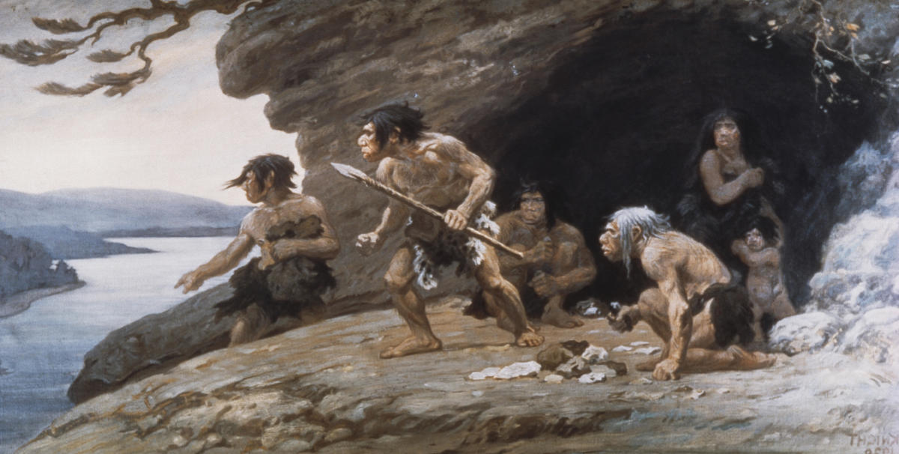
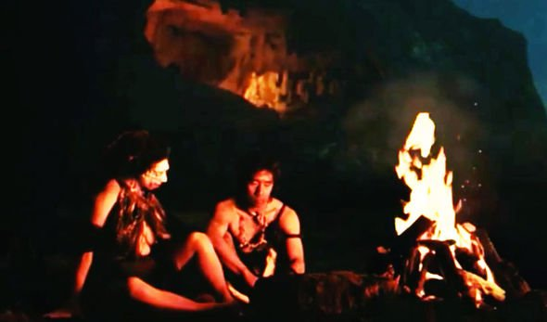
Homo neanderthalensis – Lifestyle and Culture
Learning Aim: Describe lifestyle and culture of H.neanderthalensis

Slide 9
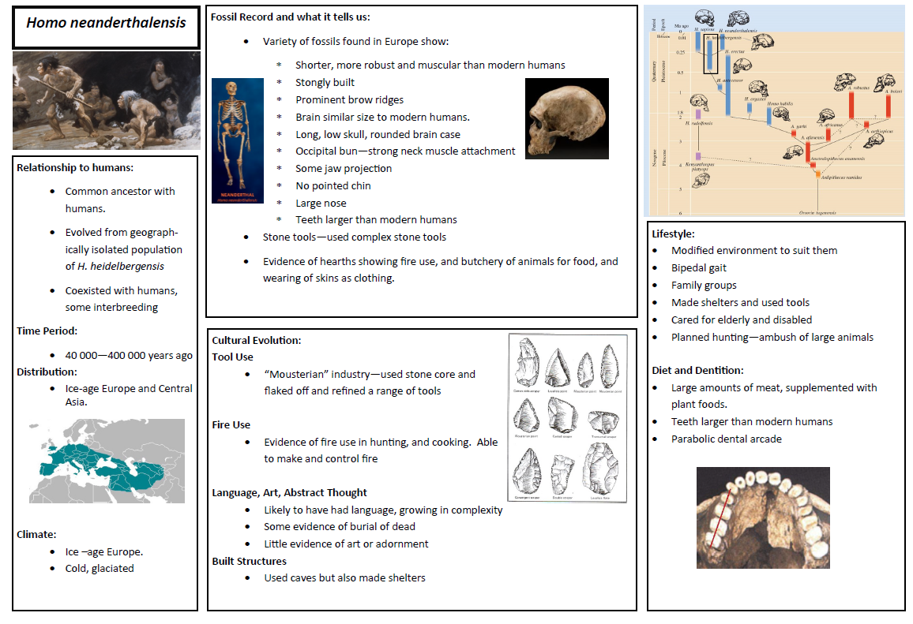

Slide 10
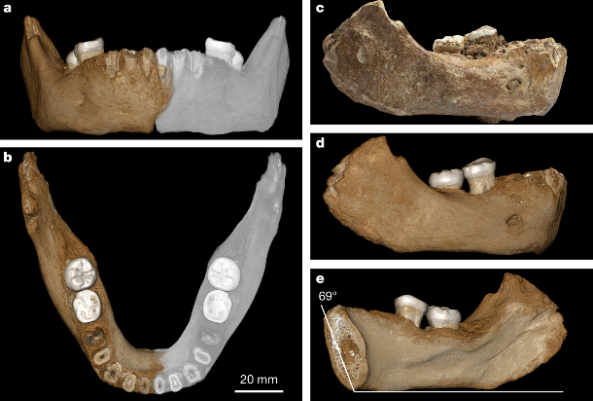
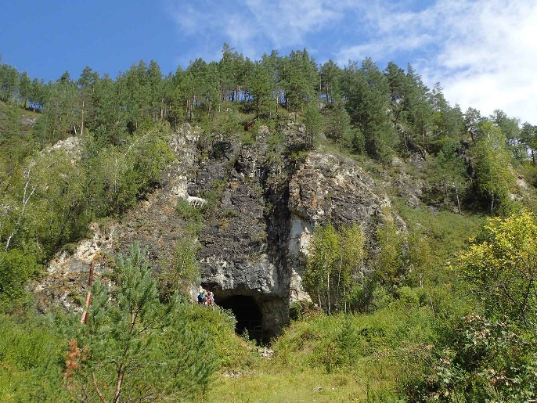
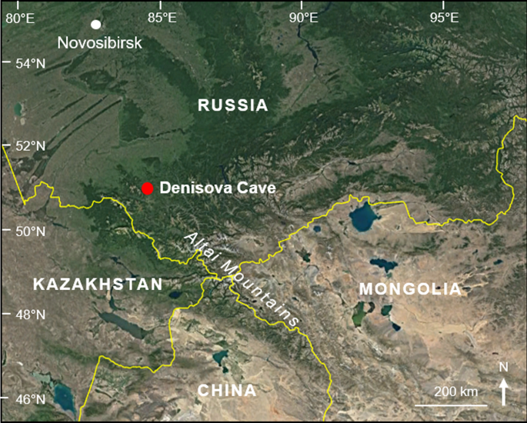
Other recent extinct hominins - The Denisovans
Bone fragment discovered in 2008
Denisova cave, Siberia
Approx 40 000 years old
mtDNA not neanderthal nor modern human
Analysis of DNA base similarity indicates common ancestor with humans and neanderthals lived 1 million years ago.
Good example of how mtDNA can be used to analyse relationships between hominins.
Nuclear DNA shows
more closely related to neanderthals than modern humans
Have interbred with modern humans, in particular ancestors of modern Melanesians and Australian Aboriginal people
Not much other evidence about culture and behaviour
More evidence will reveal more detail, and more evidence is available all the time.
Learning Aim: Briefly describe the location, time range of existence, and features of Denisovans

Slide 11
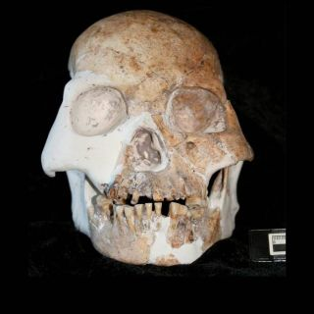
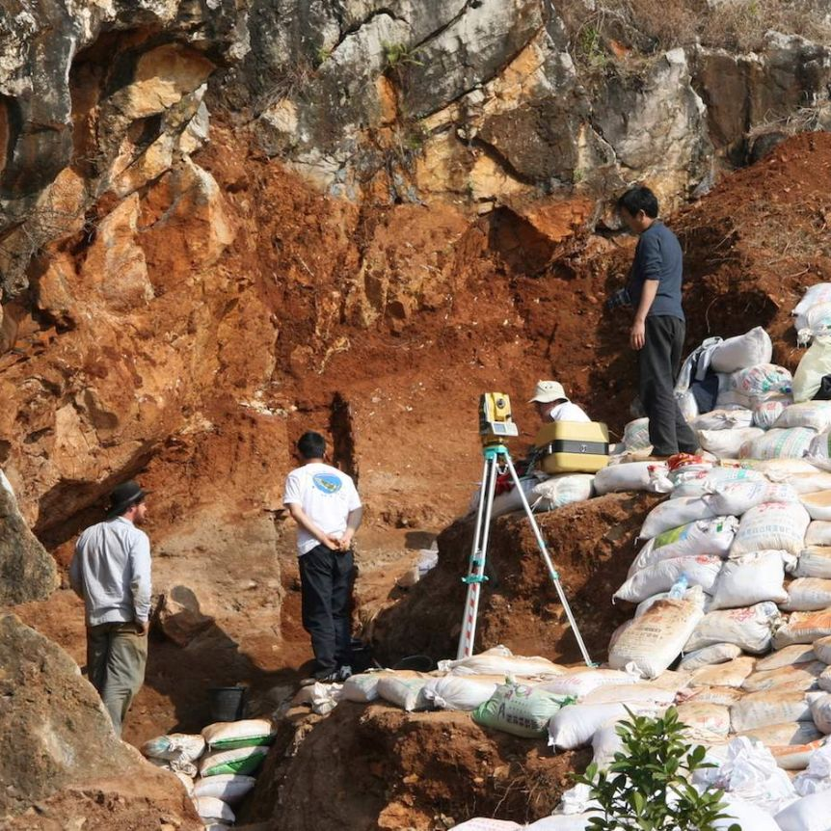
Other recent extinct hominins - The Red Deer Cave People
Skull discovered in 1979 in China
Thick bones
Prominent brow ridges
Short, flat face
Lack of chin
Anatomically unique – a previously undiscovered hominin
Evidence that they cooked lots of red deer – leading to the name
Unclear how they fit in with hominin evolution
May have evolved in East Asia in parallel with H sapiens.
May be related to Denisovans?
Survived until relatively recently – 11 500 years ago
Have not yet been able to extract enough DNA to analyse to clarify relationships
Learning Aim: Briefly describe the location, time range of existence, and features of the Red Deer Cave People

Slide 12
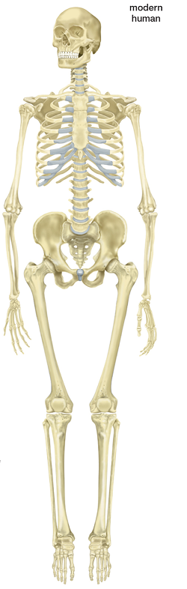
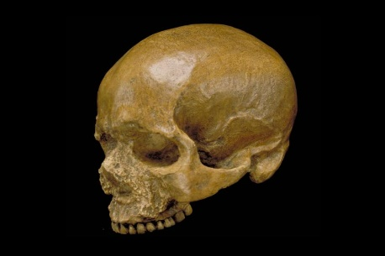
Homo sapiens – Modern Humans – overview and fossil record
Existed 300 000 years ago to present day (and future)
1868: fossils found at Cro-Magnon in France
Five people
Animal bones
Sea shell necklaces
Stone tools
Part of widespread population in Europe from 40 000 years ago to 12 000 years ago – early modern humans
Members of Homo sapiens “Cro-Magnon Man”
Less prominent brow ridges, flatter face, smaller jaw and teeth
Shorter, rounder skulls
Chin
Large brain
Well separated eye sockets
Many more fossils have been found since this initial fossil discovery
Huge amount of cultural development since first evolved
More on this next lesson
Learning Aim: Provide an overview of H.sapiens including the fossil record and anatomical features

Slide 13
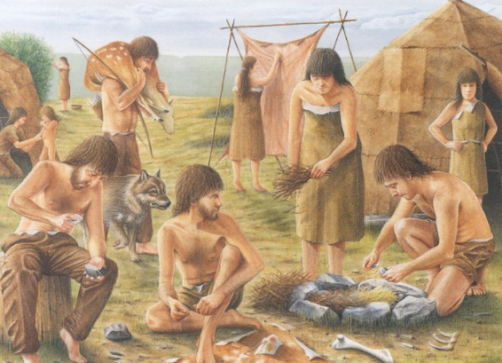
Homo sapiens – Modern Humans

